Slide 1

Analysis of Real-estate Rental Properties in USA
Parth Bhatt

Slide 2
Agenda
Goal
Dataset
EVA
Result Analysis
Dashboard

Slide 3

Goal
To create a dashboard where any new lister or buyer (tenant) will be able to examine the details of various listings for each state

Slide 4
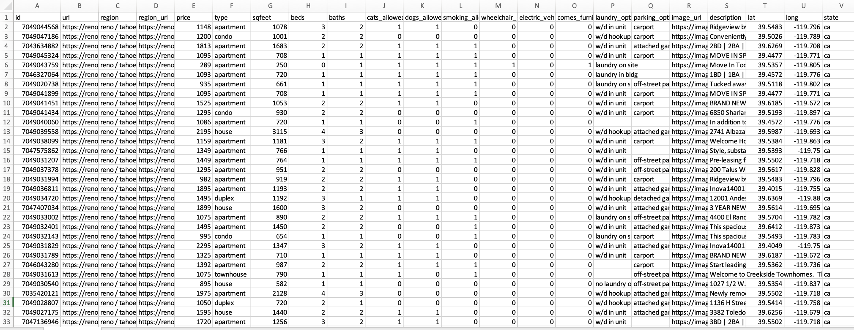
Dataset
Data source - Kaggle
Scarped from craigslist in June 2020
22 different columns and more than 38K instances

Slide 5
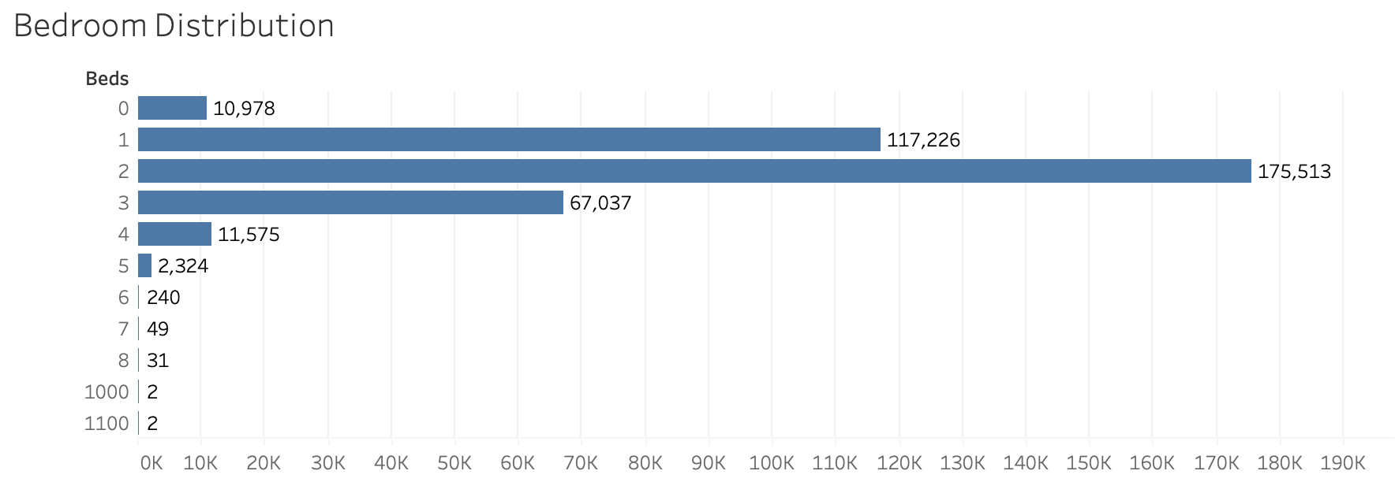
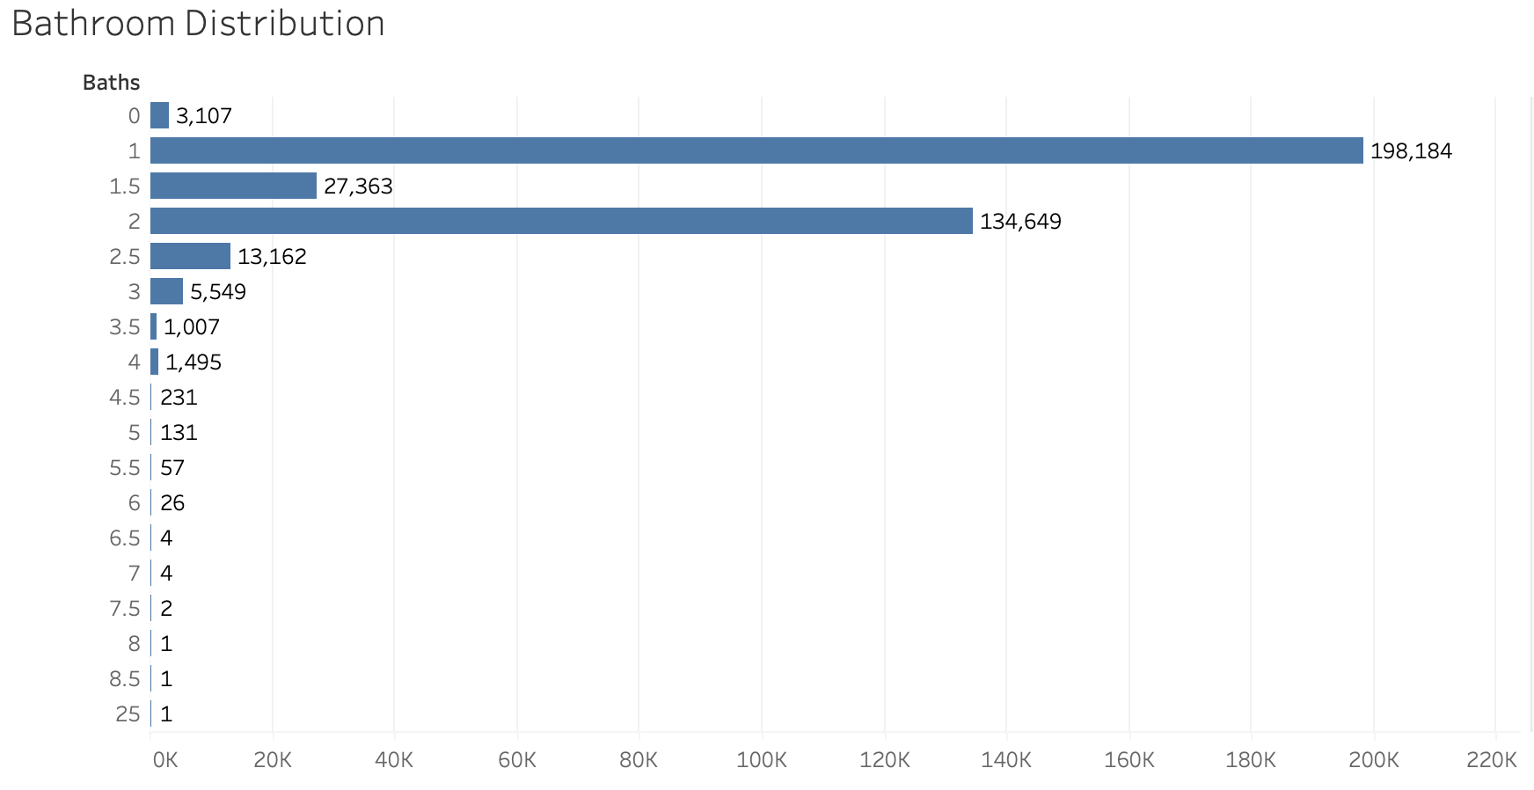
Exploration Visual Analysis (EVA)
Observed Outliers for # beds and # baths

Slide 6
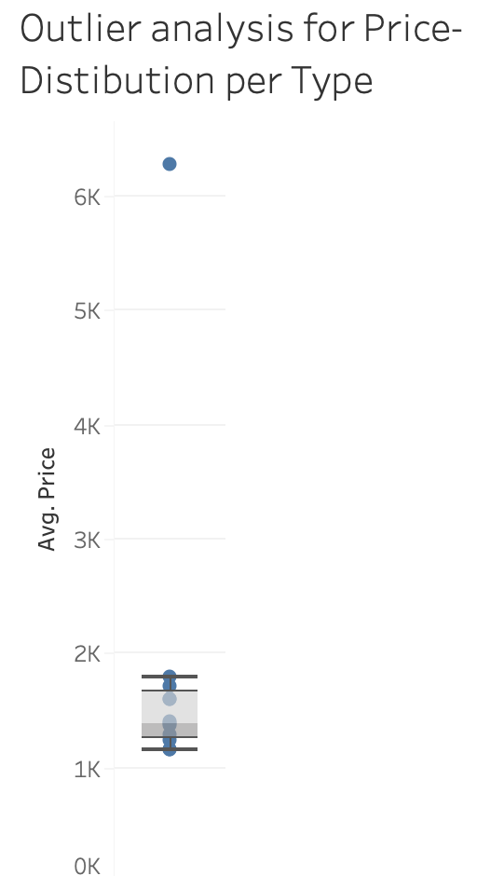
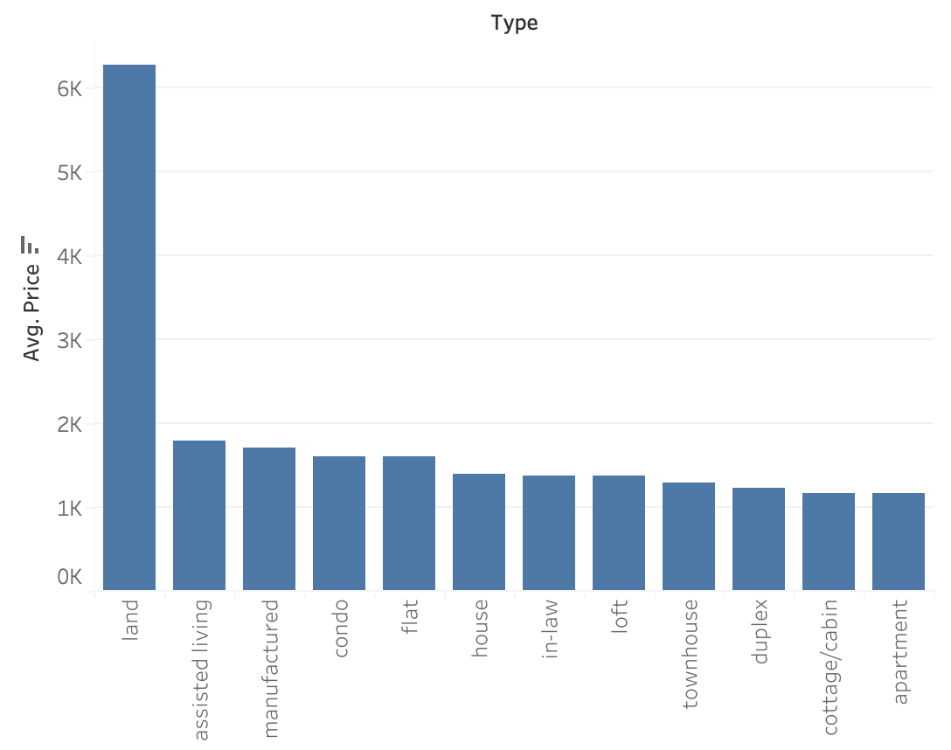
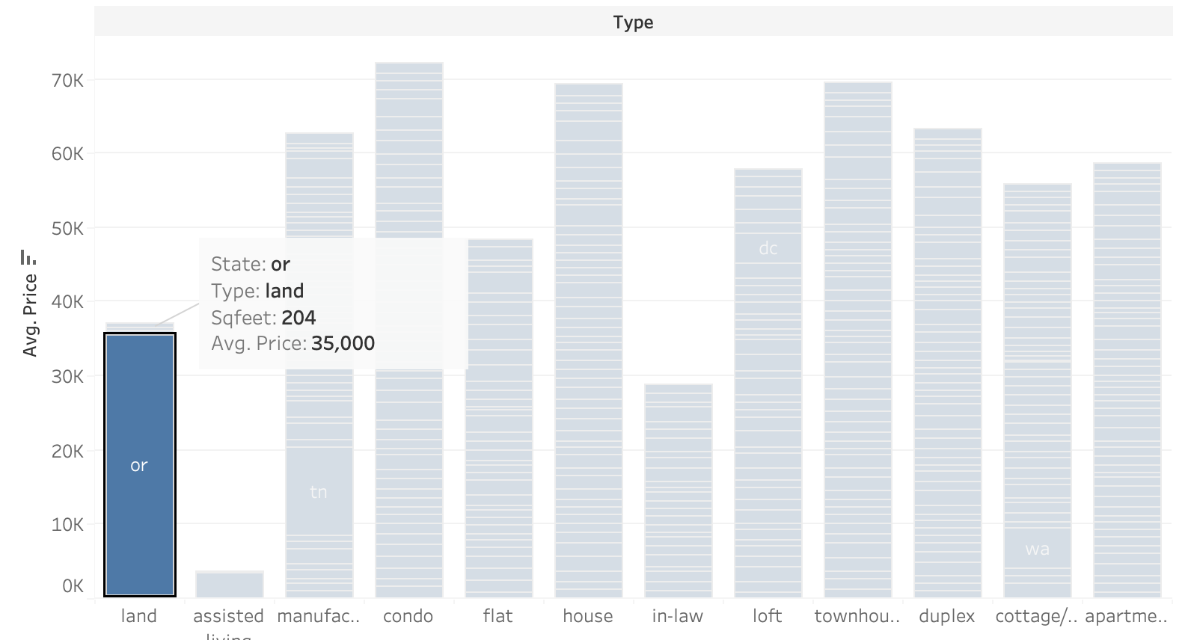
EVA (cont’d)
Observed Outliers regarding Price distribution

Slide 7
EVA (cont’d)
Assisted Living type has the highest average rental price per month
As the # bathroom increases , rental price increases too
Higher the # bedrooms, higher the rent

Slide 8

Dashboard Analysis

Slide 9
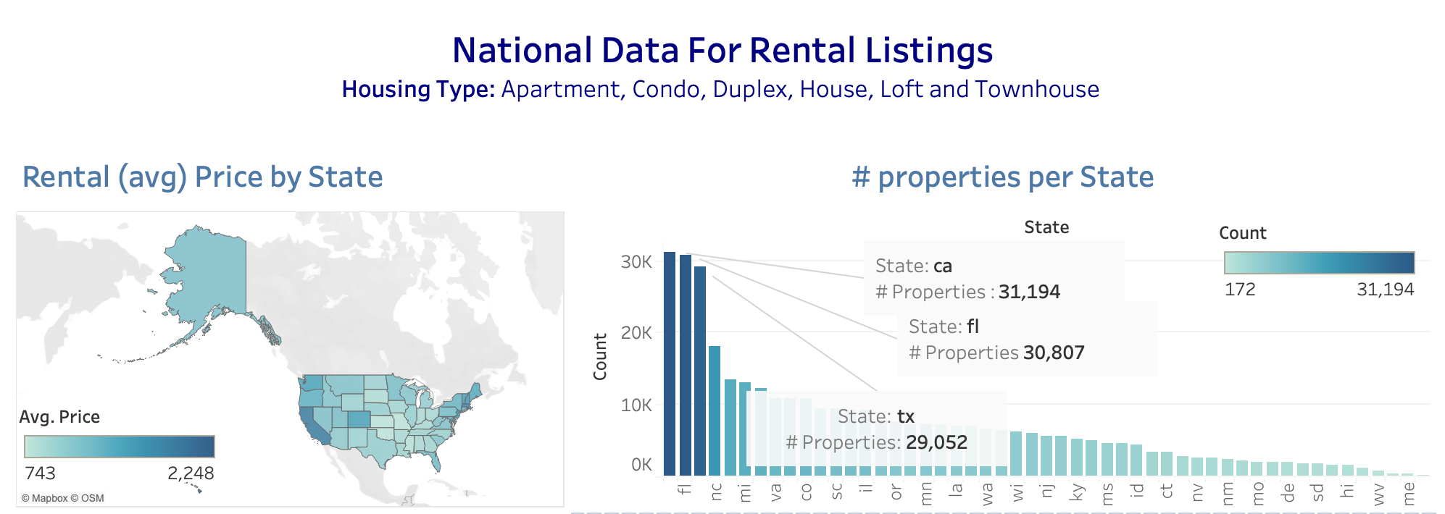
Dashboard Analysis

Slide 10
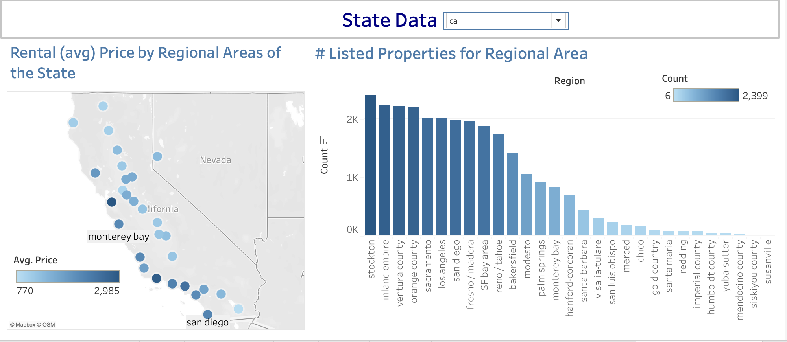
Dashboard Analysis

Slide 11
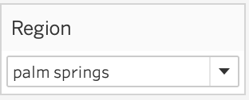
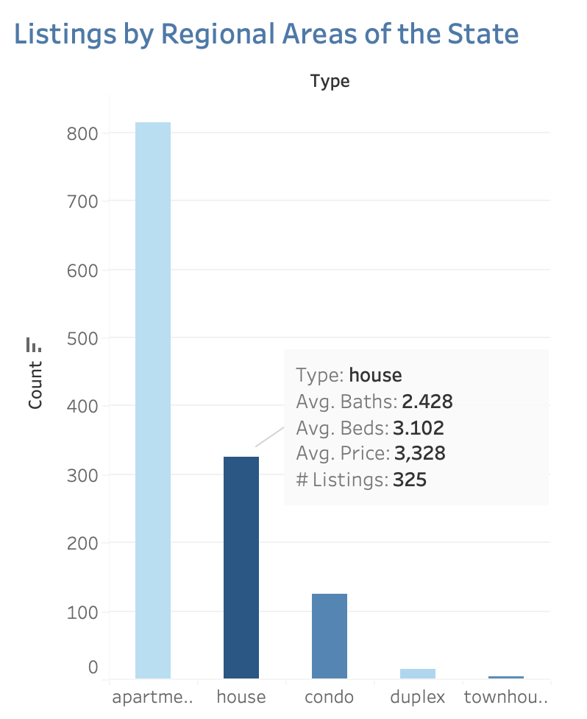
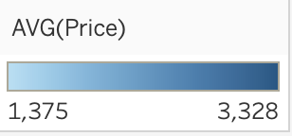
Dashboard Analysis

Slide 12
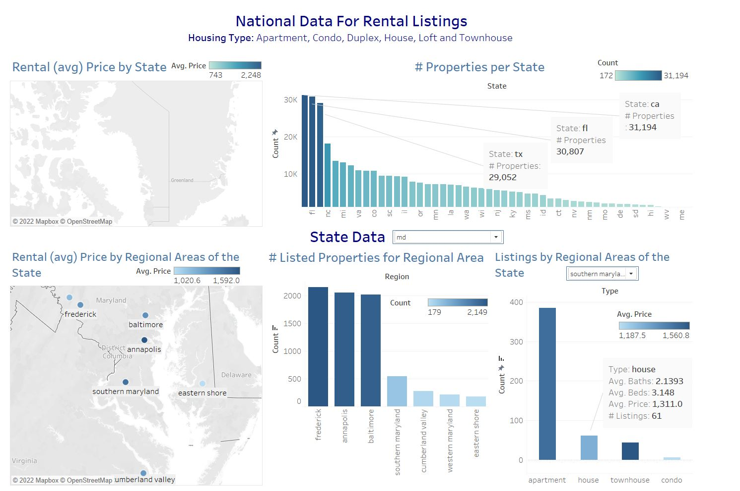

Slide 13
Thank You !

